Slide 1

Capital Budgeting Simulation Presentation
Heather Canzio
Gregory Dorleus
Jordan Gochman
Luke Littleton
Alebia Mina

Slide 2
New Heritage Capital Project Selection
Team 1's selection process relied heavily on creating the highest NPV for each year given the budget restrictions.
Our vision overall was to ensure that we created as much wealth for our shareholders while also ensuring that we maintained and expanded infrastructure to ensure no disruptions in the supply chain. We also made sure that decisions were made in the best interest of the brand, so as not to create an unseemly Public Relations concern or brand degradation.
In each year, a summation of the potential NPV combinations was created, followed by comparing the associated summation of budget to the available finances. Basically, we always aimed for the highest NPV that we could afford.
In certain cases, we relied on context clues gleaned from the project descriptions to make decisions regarding potential pitfalls of an otherwise investment-worthy decision. If anyone had a 'funny feeling' about a project, it was discussed among the members of the team.
Example: The Dolls Around the World Project emphasized that the company had little experience with marketing to diverse audiences. We sensed that this may result in lower than expected results due to the potential polarizing results.
Example: Potential revisions to an acquired magazine gave many members a sense of discomfort about how consumers would receive all the proposed changes.

Slide 3
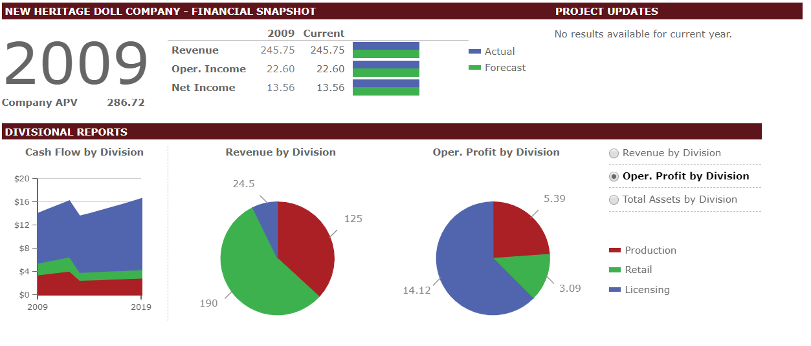

Year 1 DASHboard

Slide 4
year 1 capital project selections
Projects selected | 2010 Project Cost | Lifetime Project Cost | Discount Rate | Assumed Risk | NPV | IRR
New Doll Film/DVD | $1.05 | $3.50 | 7.4% | Medium | $9.37 | 238.61%
Store Expansion (3 in 2010, 2 in 2011) | $3.75 | $6.45 | 10.0% | High | $24.95 | 32.20%
Toddler Doll Accessory Line | $2.14 | $3.14 | 7.7% | Low | $7.14 | 25.06%
Match My Doll | $4.57 | $5.57 | 9.0% | High | $6.46 | 20.69%
TOTAL NPV | $47.92
COSTS | $11.51 | Remaining: $0.41

Slide 5
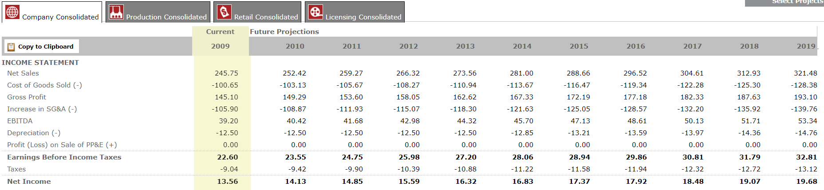
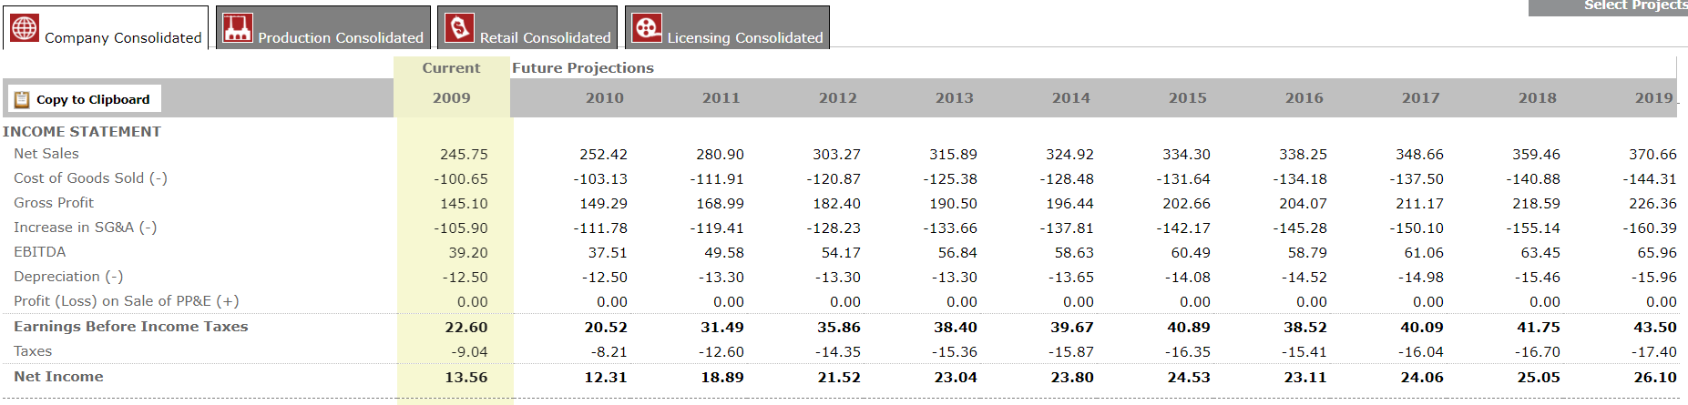
Projected Company Financials
Before Selecting Year 1 Projects
After Selecting Year 1 Projects

Slide 6
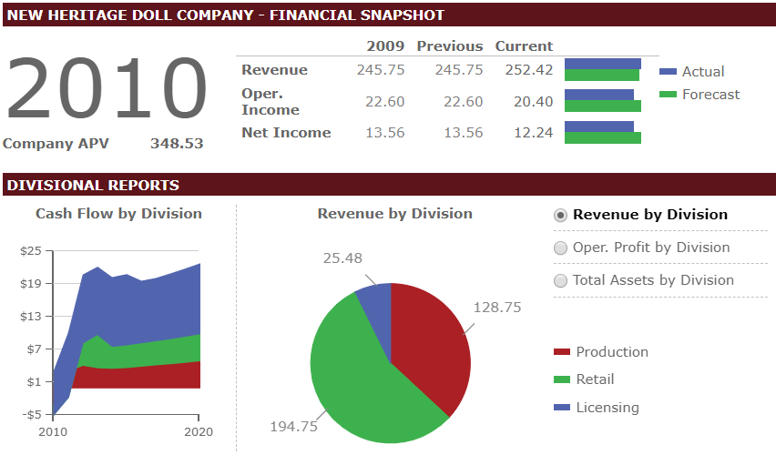
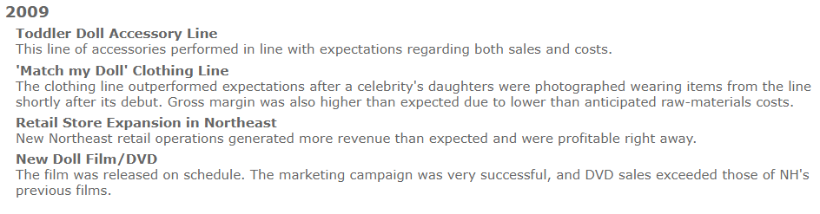
Year 2 DASHboard
Year 1 Updates

Slide 7
year 2 capital project selections
Projects selected | 2011 Project Cost | Lifetime Project Cost | Discount Rate | Assumed Risk | NPV | IRR
Tween Book Series | $0.45 | $1.61 | 6.9% | Low | $6.12 | 43.54%
Expansion of Mail-order Catalog Business to Asia | $0.55 | $2.73 | 8.5% | Low | $1.55 | 19.70%
'Grow With Me' Doll Line | $6.56 | $9.15 | 9.0% | High | $6.84 | 18.52%
TOTAL NPV | $14.51
COSTS | $7.56 | Remaining: $1.67

Slide 8
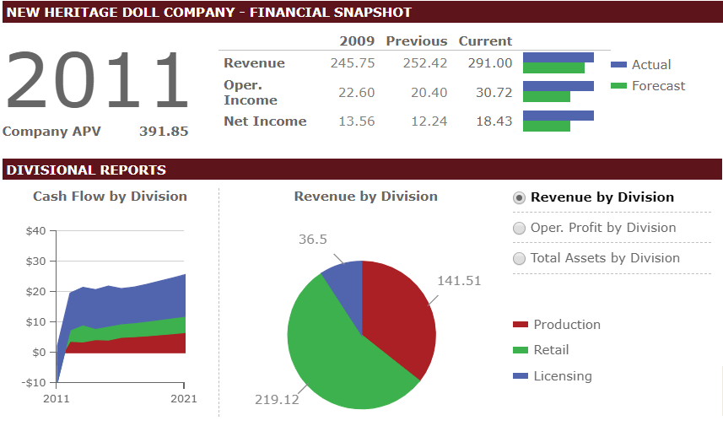
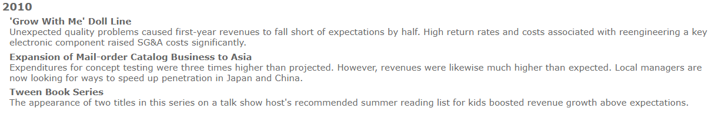
Year 3 DASHboard
Year 2 Updates

Slide 9
year 3 capital project selections
Projects selected | 2012 Project Cost | Lifetime Project Cost | Discount Rate | Assumed Risk | NPV | IRR
Acquisition of Electronic Toy Manufacturer* | $67.50* | $71.50* | 9.0% | High | $27.58 | 14.54%
'Match My Doll' Clothing Line, Expansion of Concept | $3.02 | $4.87 | 8.4% | Medium | $8.18 | 26.64%
Warehouse Facility Consolidation | $7.50 | $10.50 | 9.3% | Medium | $3.13 | 14.82%
Doll Video Game | $0.12 | $0.40 | 7.4% | Medium | $1.06 | 115.90%
New Inventory Control System for Warehouse | $0.13 | $0.19 | 8.5% | Low | $0.05 | 4.89%
Replace Assembly Equipment at Sacramento Facility | $0.08 | $0.08 | 7.7% | Low | $0.06 | 38.64%
TOTAL NPV | $12.48
*Exclude from Capital Budget
COSTS | $10.85 | Remaining: $2.15

Slide 10
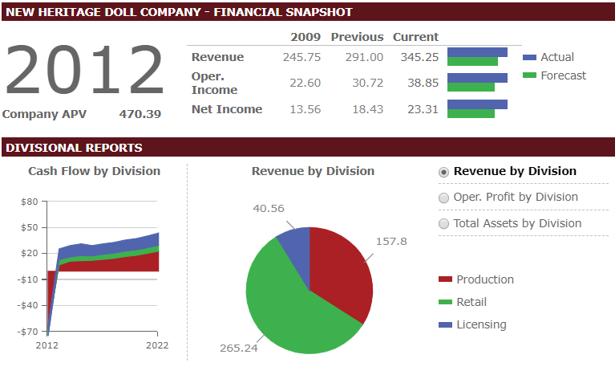
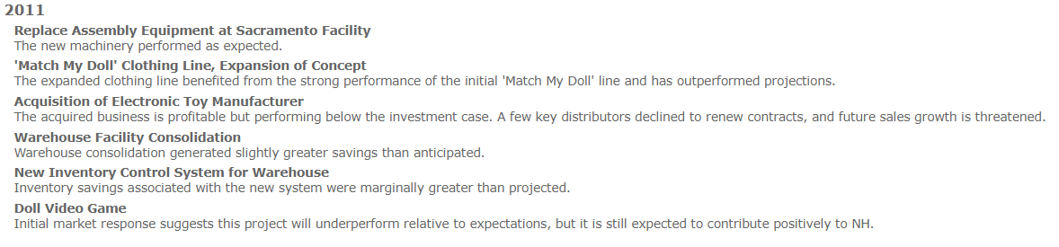
Year 4 DASHboard
Year 3 Updates

Slide 11
year 4 capital project selections
Projects selected | 2013 Project Cost | Lifetime Project Cost | Discount Rate | Assumed Risk | NPV | IRR
Toddlers Music CD Series | $0.30 | $1.03 | 7.4% | Medium | $6.97 | 104.99%
EDI Supplier Software System | $0.03 | $0.05 | 7.7% | Low | $0.05 | 40.76%
'Design Your Own Doll' | $5.57 | 7.99 | 9.0% | High | $9.77 | 21.21%
Bookstore Café and Writers' Club | $0.50 | $0.50 | 9.3% | Medium | $6.64 | 48.84%
Virtual Doll Community | $0.02 | $0.18 | 10.0% | High | $6.91 | 402.58%
Expansion to England | $0.80 | $0.80 | 9.3% | Medium | $0.92 | 18.13%
TOTAL NPV | $31.26
COSTS | $7.22 | Remaining: $6.00

Slide 12
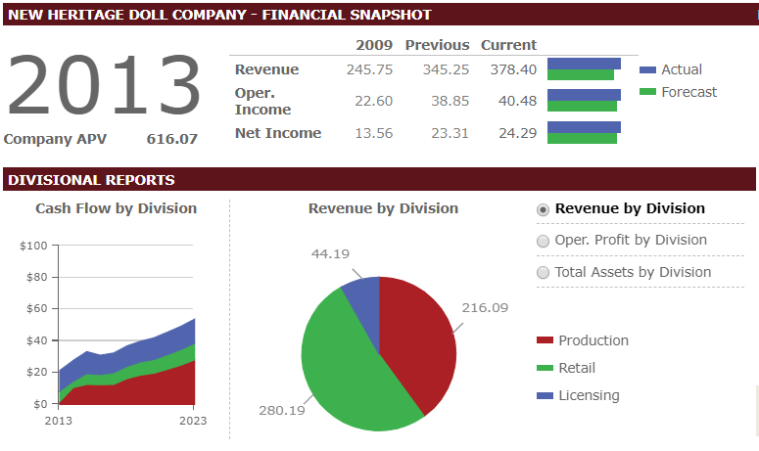
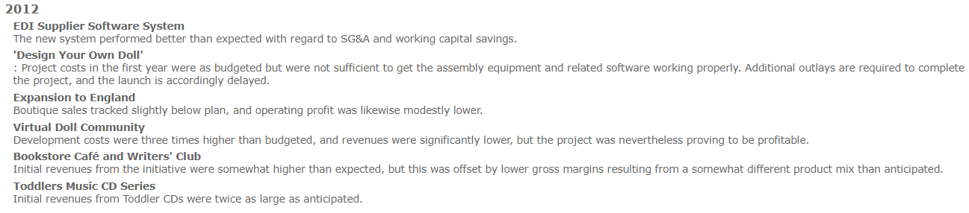
Year 5 DASHboard
Year 4 Updates

Slide 13
year 5 capital project selections
Projects selected | 2014 Project Cost | Lifetime Project Cost | Discount Rate | Assumed Risk | NPV | IRR
New East Coast Distribution Facility | $10.00 | $16.00 | 10.0% | High | $6.37 | 18.94%
Dollhouses with Miniature Dolls | $3.43 | $4.73 | 9.0% | High | $9.10 | 27.07%
Coupon Promotion/Frequent Shopper Campaign | $1.65 | $5.63 | 8.5% | Low | $5.98 | 25.10%
Young Authors Book Series | $0.38 | $1.38 | 7.4% | Medium | $8.15 | 97.95%
TOTAL NPV | $29.60
COSTS | $15.46 | Remaining: $0.16

Slide 14
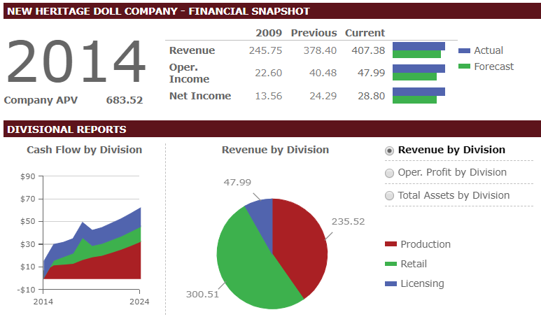
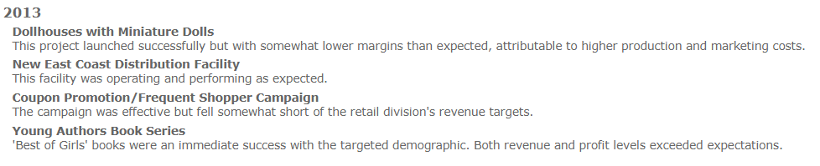
Year 6 DASHboard
Year 5 Updates

Slide 15
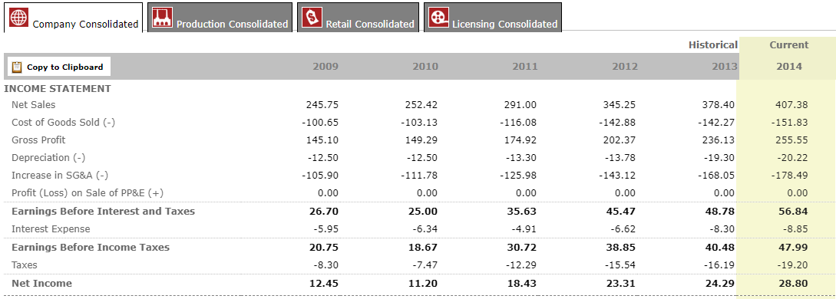
Consolidated Income Statement - Historical
Over the course of five years, we were able to more than double the net income of New Heritage (18.3% CAGR). Margins also improved during this period. Gross margins went from 59.0% to 62.7% and net margins increased from 5.1% to 7.1%. While our Year 1 selections did decrease our net income slightly, the long-term portions of the investment paid off in 2011, when the net income began to rapidly increase. While growth stagnated between 2012 and 2013, we were able rally and boost Net Income for 2013/2014 at a comparable rate to our 2010/2011 period.

Slide 16
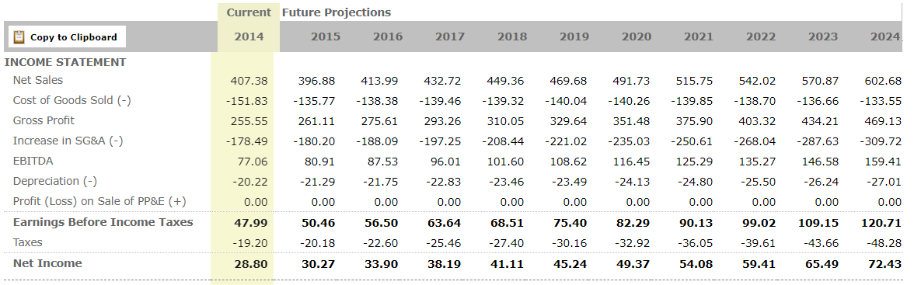
Consolidated Income statement - Future Projections

Slide 17
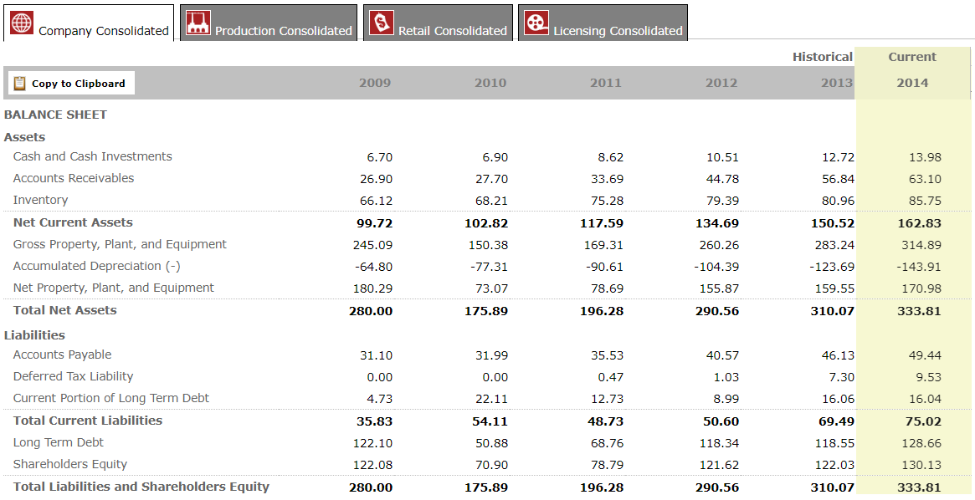
Consolidated Balance Sheet - Historical

